Slide 1



Department of Artificial Intelligence and Data Science
Next Gen Smart Fraud Detection In Energy Consumption Using Machine Learning Model
Mrs.Manoranjini
Associate Professor
SOORYA B
221801051

Slide 2
Problem Statement and Motivation
Create a machine kearning system to dtect fraudulent energy consumption patterns and unauthorized usage in smart meters.
Empowerment: Leveraging AI to enhance the capabilities of smart meters.
Detection: Focusing on identifying suspicious patterns and unauthorized usage.
Fairness and Security: Ensuring fair and secure energy distribution for consumers and providers alike.
Problem Statement:
Motivation:
Third Review
Department of Artificial Intelligence and Data Science
2

Slide 3
Objectives
Identify Anomalous Consumption: Detect unusual patterns in energy usage that indicate potential tampering, meter bypassing, or unauthorized usage.
Minimize Revenue Losses: Reduce financial losses for utility providers caused by electricity theft and fraudulent activities.
Improve Energy Efficiency: Enable more accurate and real-time monitoring of energy consumption, helping to optimize power distribution and usage.
Enhance Security: Safeguard the smart metering infrastructure against manipulation and unauthorized access.
Enable Predictive Monitoring: Use predictive analytics to proactively identify potential fraud before it leads to significant revenue loss.
Third Review
Department of Artificial Intelligence and Data Science
3

Slide 4
Abstract
This project develops a multi-model machine learning system using Convolutional Neural Networks (CNN), Artificial Neural Networks (ANN), and Support Vector Machines (SVM) to detect fraudulent energy consumption and unauthorized usage in smart meters.
By analyzing historical and real-time data, the system leverages the strengths of each model to identify unusual patterns indicative of electricity theft or tampering. The ensemble approach improves detection accuracy, reduces false positives, and helps utility providers minimize revenue losses while enhancing the efficiency and security of the power distribution network.
Third Review
Department of Artificial Intelligence and Data Science
4
Notes:
4

Slide 5
Introduction and Overview of the Project
With the rapid advancement of smart grid technology, smart meters have become integral to modern energy management systems. Smart meters provide detailed and real-time data on energy usage, enabling efficient monitoring and billing. However, this widespread adoption has also led to increased incidents of fraudulent activities, such as electricity theft, meter tampering, and unauthorized consumption. These activities pose significant challenges for utility providers, leading to substantial revenue losses and affecting the overall stability of power distribution.
Detecting fraudulent energy consumption is a complex problem due to the diverse range of consumer behaviors, seasonal variations, and the subtle nature of tampering. Traditional methods, such as manual inspections and rule-based systems, are often insufficient in identifying sophisticated fraud patterns.
Third Review
Department of Artificial Intelligence and Data Science
5

Slide 6
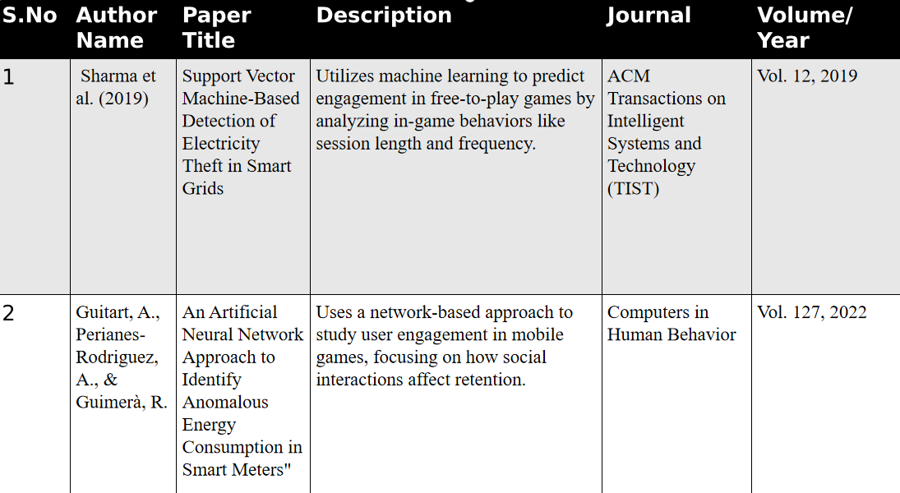
Literature Survey

Slide 7
Existing System
Rule-Based Systems: Uses predefined rules and thresholds to detect abnormal consumption patterns.
Statistical Methods:Analyzes historical data using metrics like mean, variance, and regression to detect anomalies.
Machine Learning-Based Systems:Uses algorithms like SVM and ANN to learn and identify fraud from data.
Deep Learning Systems: Leverages CNNs and RNNs to capture complex temporal and spatial patterns
Third Review
Department of Artificial Intelligence and Data Science
8

Slide 8
Drawback of Existing System
Rule-Based Systems: Rule-based systems are prone to high false positives, lack adaptability, and require frequent updates.
Statistical Methods: Statistical methods struggle with complex patterns, are sensitive to noise, and don’t scale well with large datasets.
Machine Learning-Based Systems: Machine learning-based systems can fail to capture all fraud types, especially in imbalanced datasets, and require significant computational resources..
Deep Learning Systems:Deep learning systems need large amounts of labeled data, have high false positives, and are hard to interpret, limiting their practical use.
Third Review
Department of Artificial Intelligence and Data Science
9

Slide 9
.
Proposed System
The proposed system integrates Convolutional Neural Networks (CNNs), Artificial Neural Networks (ANNs), and Support Vector Machines (SVMs) to improve fraud detection in smart grids.
CNNs will capture spatial and temporal patterns in energy consumption, helping detect complex anomalies in time-series data.
ANNs will model non-linear relationships in the data, learning from historical usage patterns to identify various types of fraudulent activity.
SVMs will classify and detect outliers, effectively identifying subtle or rare instances of fraud.
The integration of these models leverages their strengths for a more accurate, robust, and adaptable fraud detection system.
Third Review
Department of Artificial Intelligence and Data Science
10

Slide 10
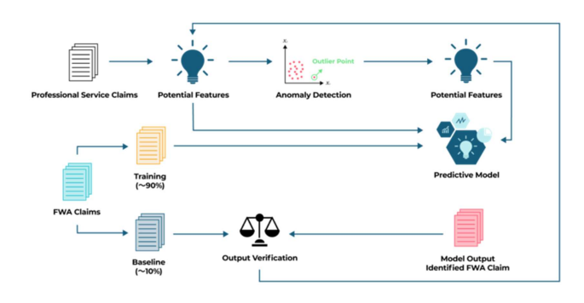
System Architecture

Slide 11
Lists of Modules
Data Preprocessing Module
Feature Extraction Module
Model Training Module
Fraud Detection Module
Ensemble Learning Module
Real-Time Monitoring Module
Model Evaluation and Optimization Module
Visualization and Reporting Module
User Interface (UI) Module
Third Review
Department of Artificial Intelligence and Data Science
13

Slide 12
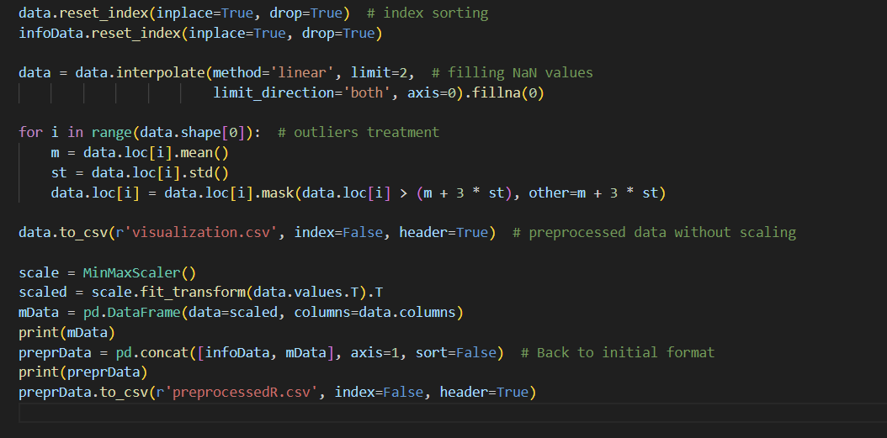
Module 1:Data Preprocessing Module
Pre Process:
Cleans and prepares raw smart meter data for analysis.
Handles missing values, normalizes consumption data, and converts time-series data into suitable formats for model training.(stores as preproc.csv)
Third Review
Department of Artificial Intelligence and Data Science
14

Slide 13
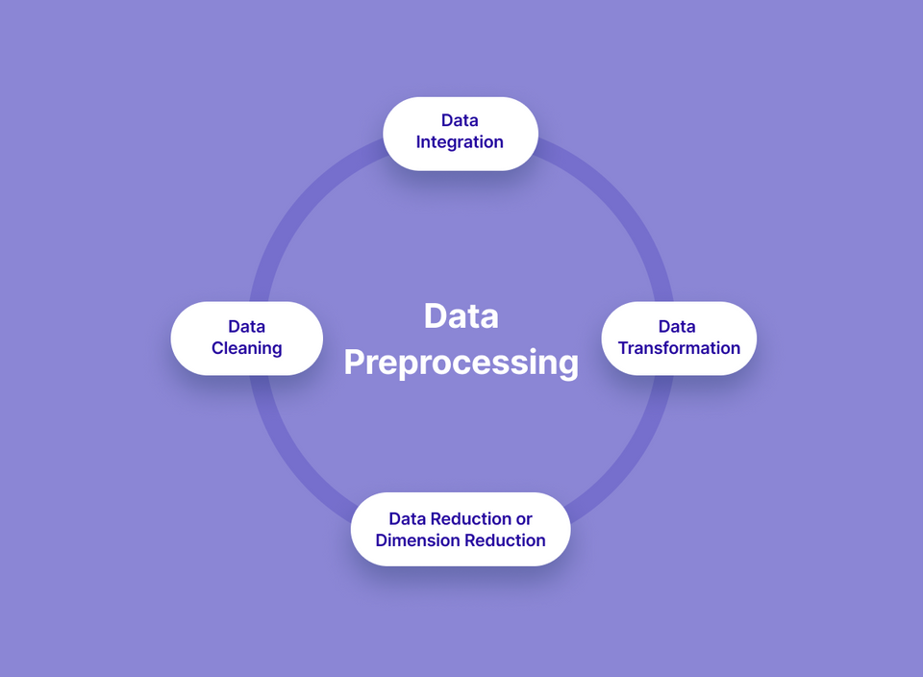
Module 1:Data Preprocessing Module
DATA FLOW DIAGRAM :
Third Review
Department of Artificial Intelligence and Data Science
15

Slide 14
Module 1:Data Preprocessing Module
Output: Cleaned and normalized data, with missing values imputed and time-series data properly formatted for further processing.
Example: A dataset of energy consumption with consistent timestamps and normalized energy usage values, ready for feature extraction.
Third Review
Department of Artificial Intelligence and Data Science
16

Slide 15
Module 2: Model Training Module
The machine learning models (CNN, ANN, and SVM) are trained using the TensorFlow library on an electricity dataset (e.g., from Kaggle).
After training, the model is able to classify energy consumption data as either normal or fraudulent.
The model uses algorithms like Decision Tree, Random Forest, and Logistic Regression to make predictions on the consumption data.
Third Review
Department of Artificial Intelligence and Data Science
17

Slide 16
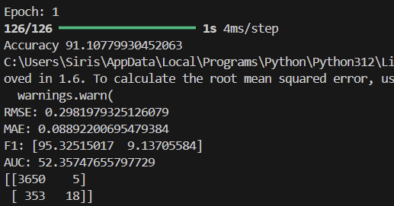
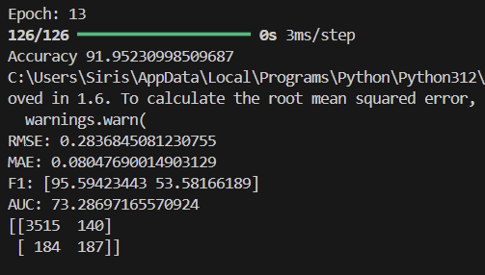
Module 2: Model Training Module
OUTPUT SCREENSHOT
Device Performance vs. Settings Graph
Player Behavior Heatmap
Third Review
Department of Artificial Intelligence and Data Science
19

Slide 17
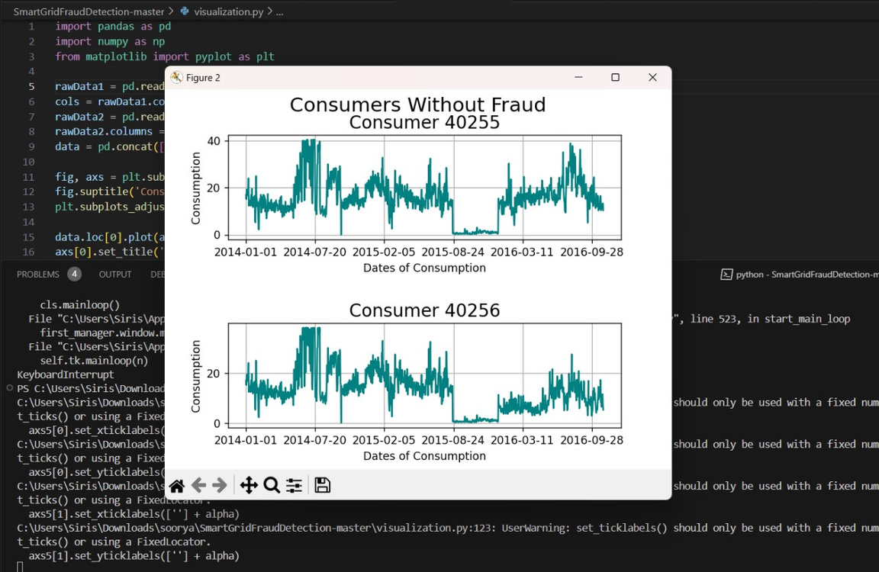
Module 3: Fraud Detection Module
Fraud Detection Module
Output: Alerts or flags for potential fraudulent activities, such as unauthorized usage or energy theft, detected in real-time consumption data.
Example: A notification indicating that a specific user has exhibited abnormal consumption patterns, flagged for investigation.
21
Third Review
Department of Artificial Intelligence and Data Science

Slide 18
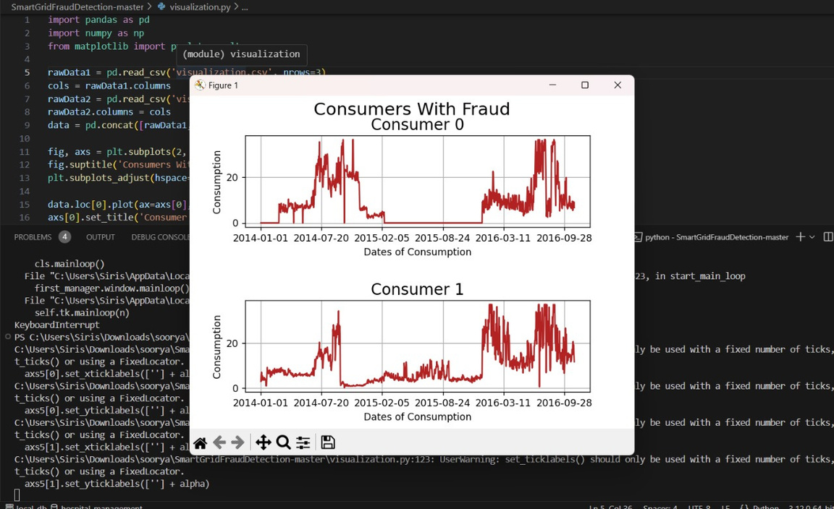
Module 3: Fraud Detection Module
OUTPUT SCREENSHOT:
21
Third Review
Department of Artificial Intelligence and Data Science

Slide 19
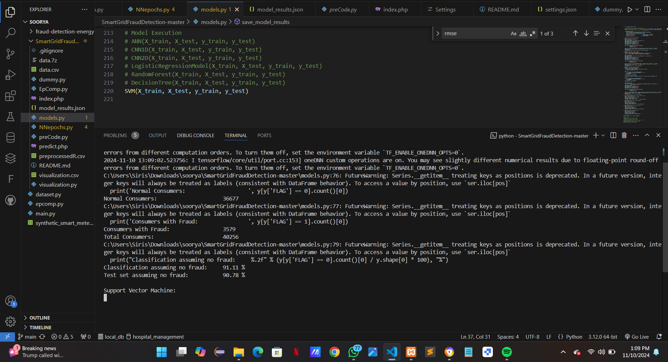
Module 3: Fraud Detection Module
OUTPUT SCREENSHOT:
21
Third Review
Department of Artificial Intelligence and Data Science

Slide 20
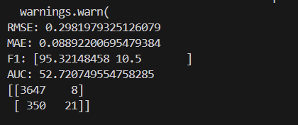
Module 4: Model Evaluation and Optimization
Output: Performance metrics such as accuracy, precision, recall, and F1-score, along with optimization suggestions for the models.
Example: A report showing that the SVM model has an accuracy of 95%, but the ANN model needs optimization to improve recall for fraud detection.
Third Review
29
Department of Artificial Intelligence and Data Science

Slide 21
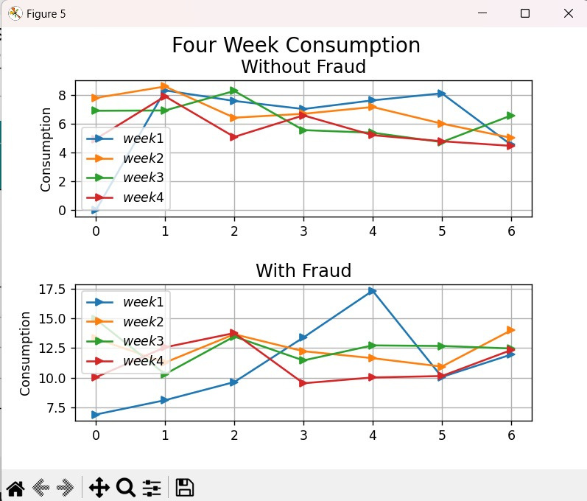
Module 5: Visualization and Reporting
Output: Visual graphs and detailed reports of detected fraud patterns, trends, and analysis of flagged cases.
Example: A bar chart displaying the frequency of fraud cases detected per month and a detailed PDF report summarizing suspicious activities.
Third Review
Department of Artificial Intelligence and Data Science
31

Slide 22
FINAL OUTPUTS
Tech Stack Summary:
Website:
HTML, CSS, JavaScript for front-end design and interactivity.
XAMPP (PHP) for hosting the website and server-side interaction with the machine learning model.
Machine Learning Model:
TensorFlow as the framework for training models.
CNN, ANN, and SVM for fraud detection.
Decision Tree, Random Forest, and Logistic Regression algorithms for classification.
Evaluation:
Metrics: RMSE, F1 Score, AUC, and Confusion Matrix to assess model performance.
Output:
JSON data containing prediction results: normal consumer count, fraud count, total consumer count, and fraud percentage.
Third Review
Department of Artificial Intelligence and Data Science
31

Slide 23
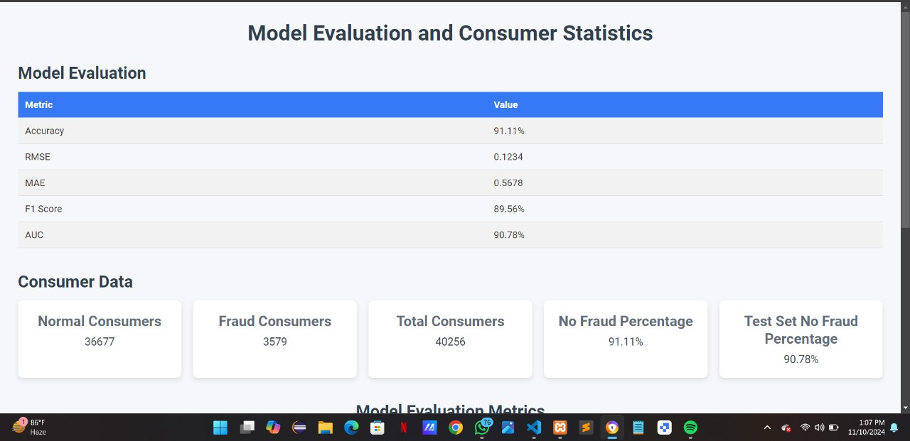
FINAL OUTPUTS:WEBSITE
Third Review
Department of Artificial Intelligence and Data Science
31

Slide 24
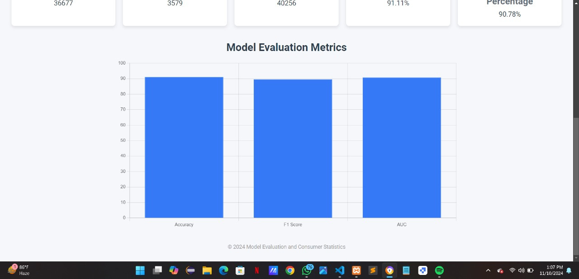
FINAL OUTPUTS:WEBSITE
Third Review
Department of Artificial Intelligence and Data Science
31

Slide 25
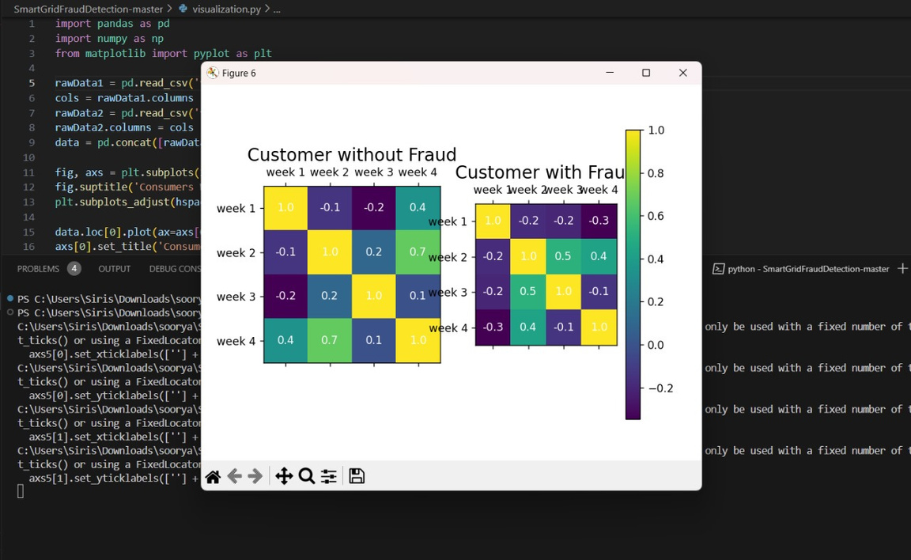
FINAL OUTPUTS:ML MODEL
Third Review
Department of Artificial Intelligence and Data Science
31

Slide 26
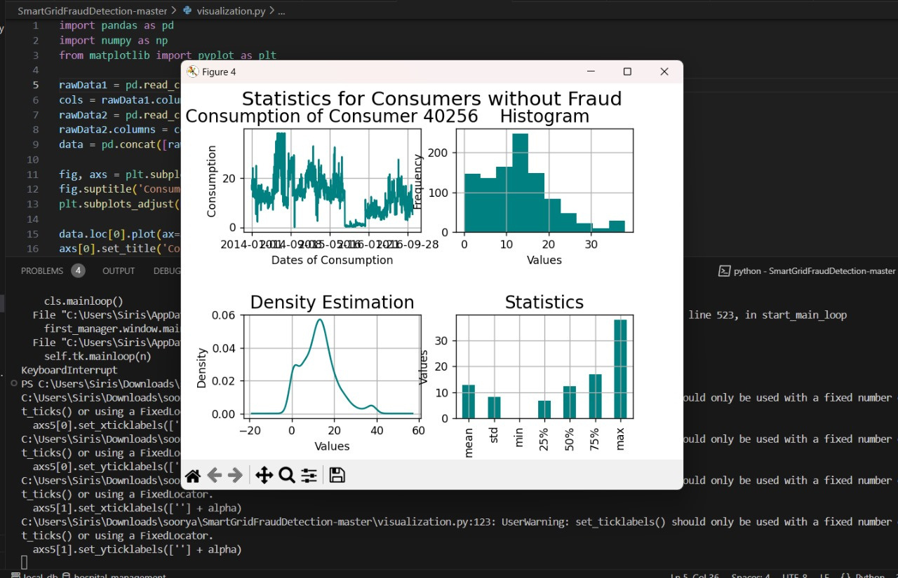
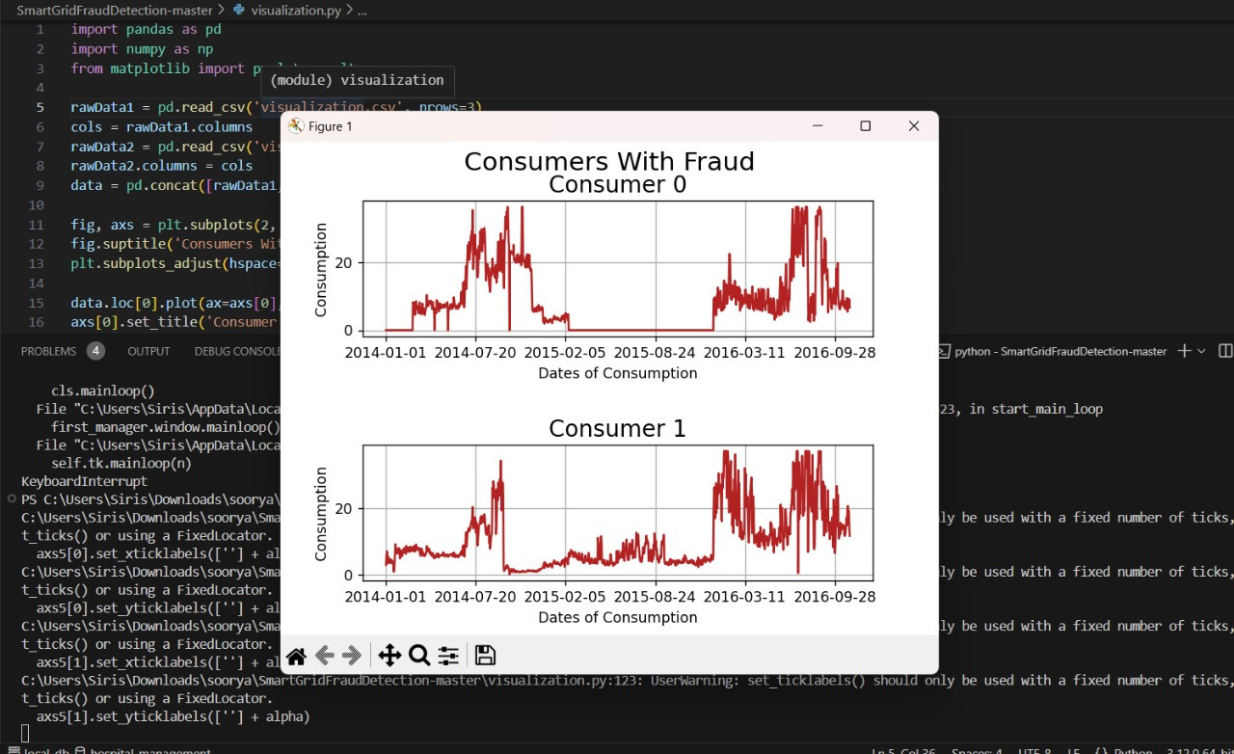
FINAL OUTPUTS:ML MODEL
Third Review
Department of Artificial Intelligence and Data Science
31

Slide 27
References
A. K. Sharma, P. K. Sahu, and N. M. Pandey, "Fraud Detection in Smart Grid Energy Consumption Using Machine Learning Algorithms," Journal of Electrical Engineering & Technology, vol. 13, no. 4, pp. 1672-1681, 2018.
S. S. Bhowmick and A. Chatterjee, "Fraud Detection in Smart Grid Using Machine Learning Techniques," in Proceedings of the 2019 IEEE Calcutta Conference (CALCON), Kolkata, India, 2019, pp. 217-221.
M. S. M. Rahman, M. S. Z. Abedin, and M. A. H. Bhuiyan, "A Survey on Fraud Detection Techniques in Smart Grids Using Machine Learning," International Journal of Advanced Computer Science and Applications (IJACSA), vol. 11, no. 9, 2020.
Third Review
Department of Artificial Intelligence and Data Science
34

Slide 28
Thank You
Third Review
Department of Artificial Intelligence and Data Science
35

